Slide 1
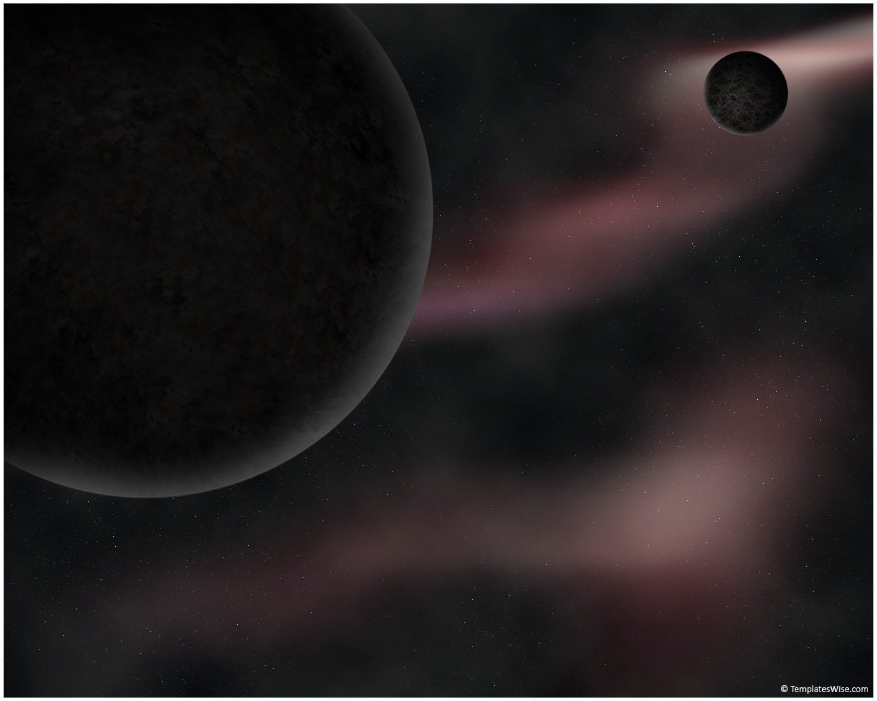
Morphological Analysis of Galaxies from High-Resolution Simulations Using Automated Detection
Ian Tibbetts, Ariunjargal Bat-Erdene Prof.Elizabeth McGrath
Notes:
Ian: Hello everyone,
Today, we will be talking about our study of galaxy morphology from high-resolution simulations using automated detection. There are several reasons why we were interested in conducting this research.

Slide 2

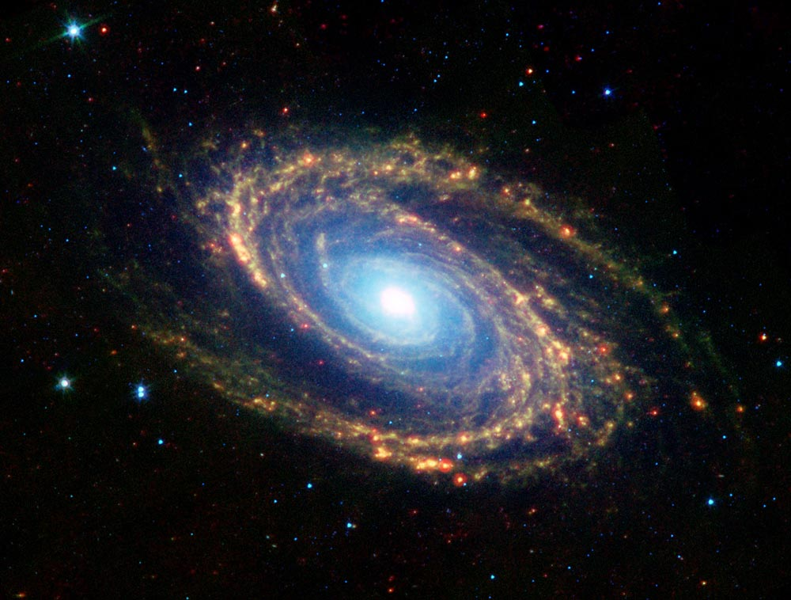
Why we care
Space is cool and tantalizing; there is a lot to explore
Our cosmic origin (how did we get here)
Part of emerging collaborations between observers and theorists in the field
Interdisciplinary: CS and Physics/Astronomy
Notes:
Space is cool –- perceived to be boundless , tantalizing space up in the sky for human since our origin
2) Our cosmic origin– Age of the universe, where we came from and how it evolved to today, our cosmic origins
- As our planet orbits around the Sun, which is a star and belongs to a galaxy that is a one of millions of its of kind, it is important to understand what physics are behind the creation by studying the galaxy formation.
3) Observational and theoretical astronomers – cooperation between these two parts of astronomy is a key step towards understanding more about galaxy morphology and our cosmic origins
- Not so long ago, work of observers and theorist were done separately. However, in this project, using the collaboration of the two group, we hope to come up with better simulations.
4) Interdisciplinary – Python used to automate tools used by astronomers
In addition of working on the astrophysics side of the project, it also required us to use programming language Python in the process of automating the code.
As we know, the space has been of great interest to humans since our origin. There have been numerous efforts to understand this tantalizing, perceived-to-be-boundless space that lies above us. Rapid development in field of astrophysics informed us about the many properties of our universe. As we know, our planet Earth is a moon to the Sun, which is a typical star; each galaxy consists of millions of them. To understand our cosmic origin better, we must inspect and understand how galaxies are formed. In that regard, our project is compelling because not only we study the galaxy morphology, but also it is a part of relatively new collaboration between observational and theoretical astronomers. In addition, the project is interdisciplinary integrating two different fields: Astrophysics and Computer Science

Slide 3
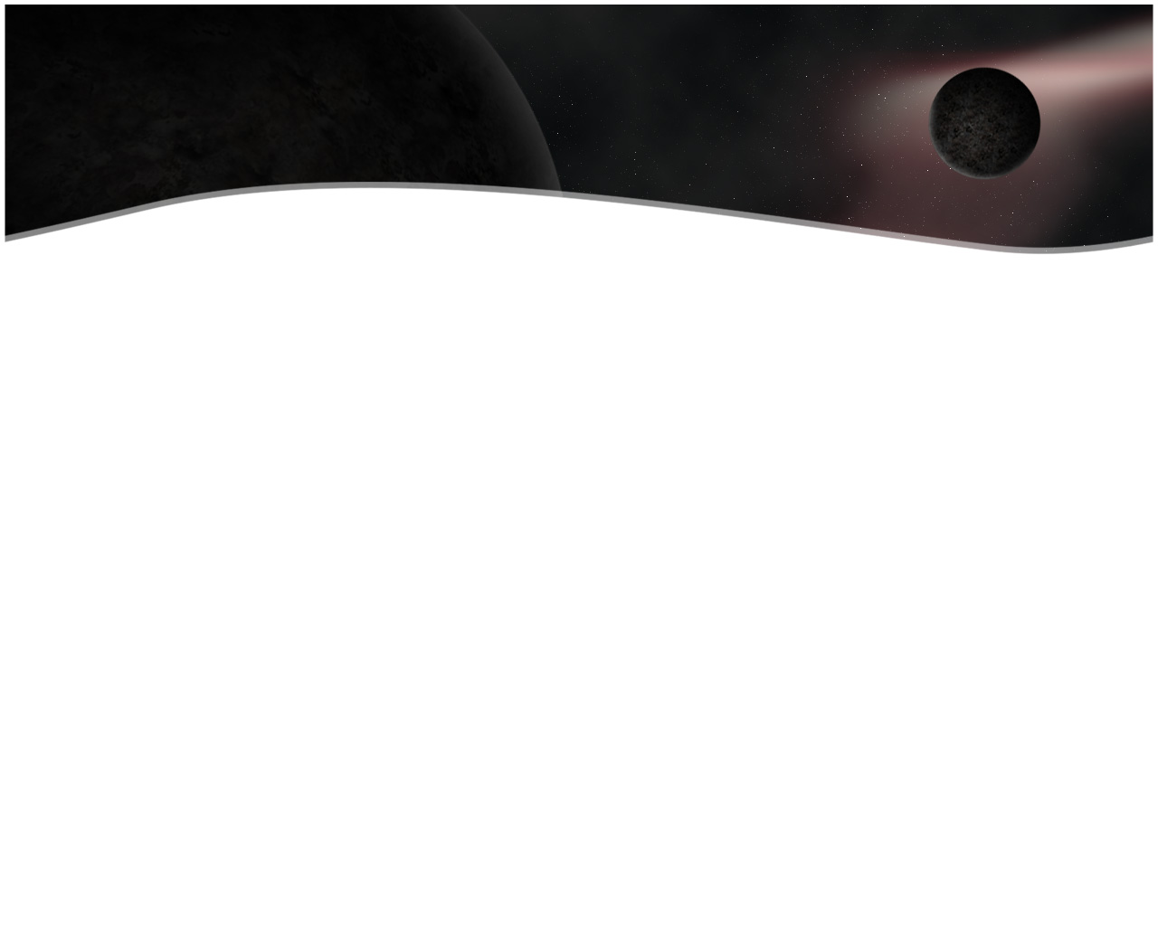
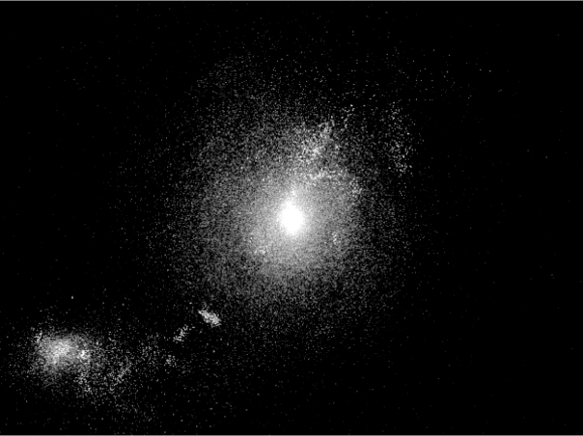
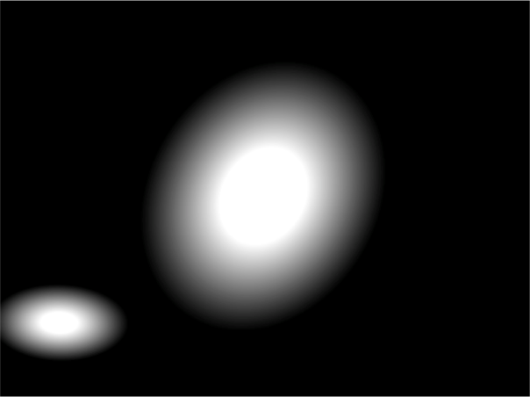
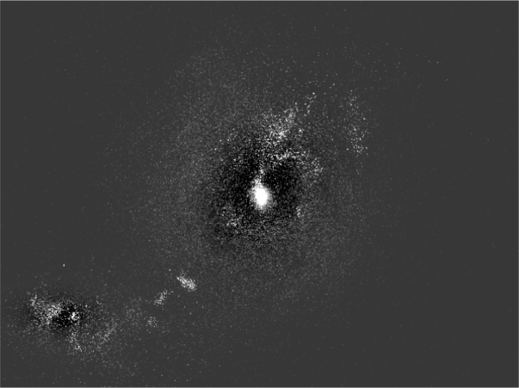
What we’re doing
High-resolution simulations
Hundreds of images for each galaxy
Automated fitting of elliptical models
Figure1: Image of a simulated galaxy, elliptical model produced by our program running GALFIT and finally the residual (from left to right)
Notes:
1)High-resolution simulations – images produced from fully cosmological (meaning that simulation of a galaxy made while considering its surrounding area in the universe), mass simulations of evolving universe
2)Hundreds images for each galaxy generated using different time steps over billions of years, multiple camera angles and filters
3)Automated fitting – use elliptical models to get info about galaxies that can be compared with observable parameters
In this project, our main goal is to measure how well the current simulations match the galaxies we observe in the sky. This will allow us to inform future simulations, and eventually achieve a quality that can enhance our ability to understand observations made from the Earth. We use high-resolution simulations, provided by ?????????????; they consist of hundreds of images per galaxy during its simulated life. The sheer number of images means that we have to automate the modeling of the galaxies depicted and the collecting of results, which is the task of this summer research project. The simulations used are fully cosmological, meaning that their surrounding areas are also taken into account for the simulations since masses in the close-by areas fall into the galaxy. The figure1 shows the simulated galaxy and elliptical model that is fit into it using our program outputs and finally the residual for a typical galaxy. We can see that fit was great because of the two-component nature of this specific galaxy. Galaxies can have two kinds of component in it: bulge, a round structure made primarily of old stars, gas and dust and disk, a flattened region that surrounds the bulge in a spiral galaxy.

Slide 4
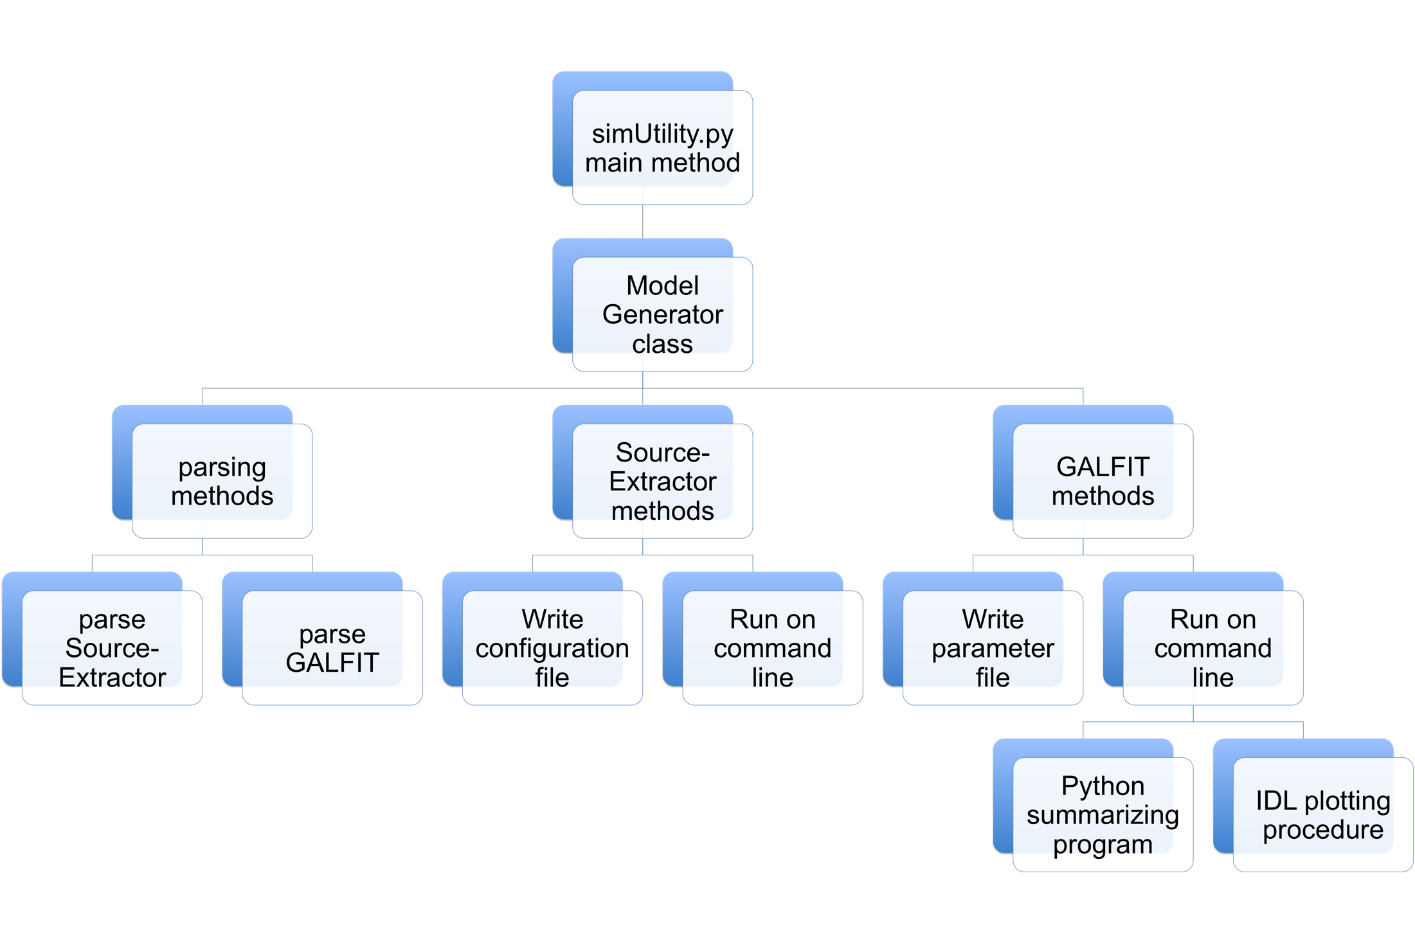
How we’re doing it
Source-Extractor
GALFIT
Python program
IDL procedure
Notes:
Sextractor – to set up the configuration file to work with our images, yields location and initial guesses for all galaxies in the image
Galfit – to use Sextractor output to write the parameter file to feed Galfit, yields a refined elliptical model and an image of the model and the residual with the original
Python – to mediate passing information between the above and to organize the at least to 6 output files for each image
IDL- to plot the aggregate output for a galaxy ; we can detect how good were the simulation by comparing them with the real observations
We have three major programs that handle the process: Source Extractor, GALFIT and Python program. First, as we pass the initial simulations to Sources Extractor, it identifies all of the galaxies in the image and guesses their properties.
Then, The data generated is sent to GALFIT that refine the guesses made by Source Extractor and output the model and residual of a galaxy. Due to numerous images involved, we used Python to run the list of images and organizes their output. Once the aggregate result is gathered for a galaxy over its simulated life, we plotted its parameters such as Sersic Index vs Age in order to see how good the model is.

Slide 5
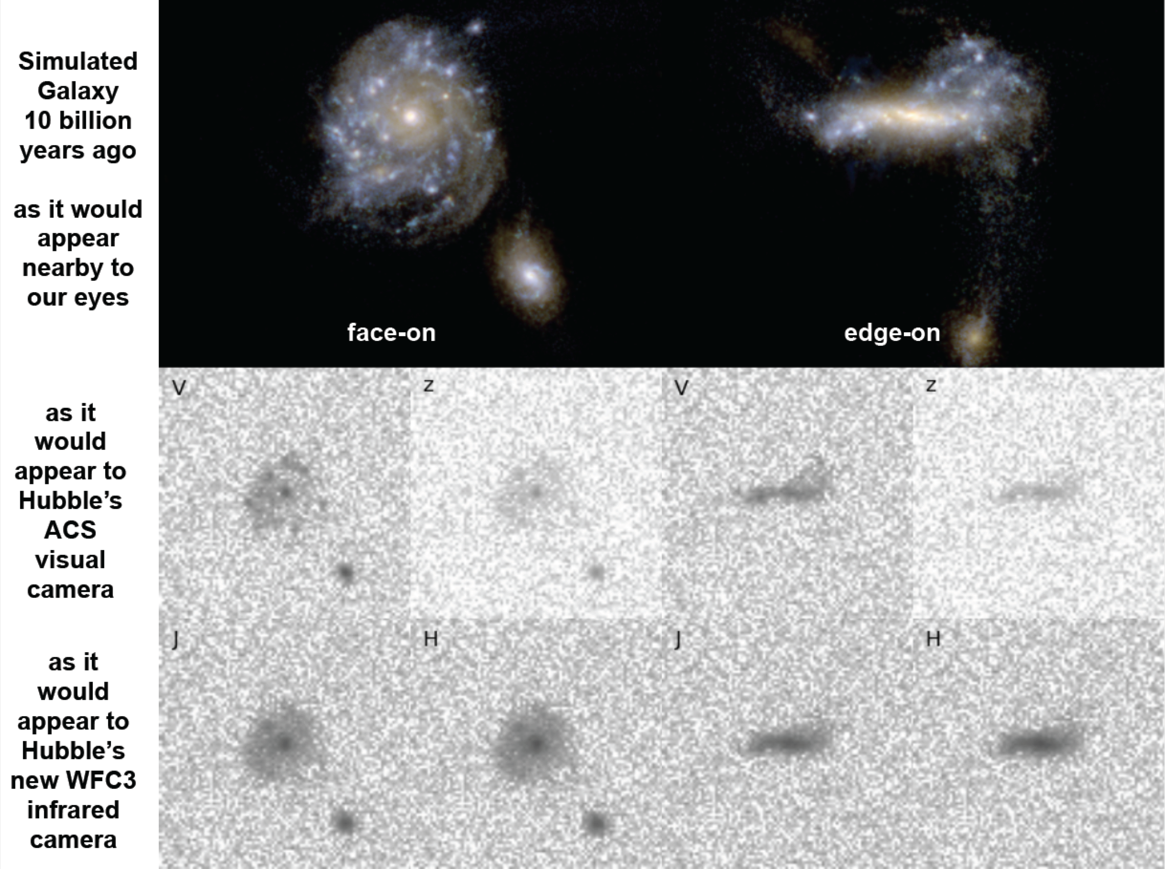
Future Work
“CANDELize” the simulations to compare with observations.
Notes:
Degrade them to replicate what galaxies look like in the Early Universe.
Take the simulations which model the mass distribution of galaxies in a cosmological context. Apply a radiative transfer model plus dust in order to visualize the light distribution. Basically computes a spectral energy distribution based on the age of stars and amount of dust at each point in the simulation and at each viewing angle. “Observe” the simulations by passing them through a model of the HST + WFC3 detector optical system which includes convolving with the Point spread function (an effort that I lead for the CANDELS team) and adding detector and sky noise to the images. Then analyze them in the same way we analyze the observations (e.g., sersic indices, etc.).
Joel – VELA27

Slide 6
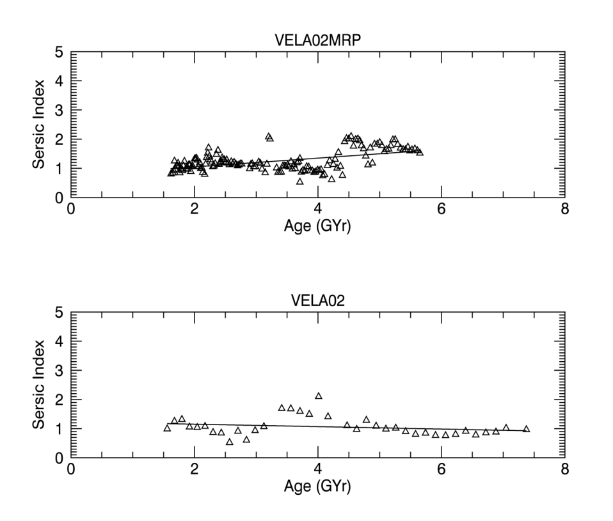
What we’ve accomplished
Came up with good Python program that has a powerful and consistent interface with the user n the command line
Successfully modeled most galaxies in the simulated images
Automated the process of running several galaxies simultaneously
Figure2: A simulated galaxy’s Sersic indices plotted over time, a representative result
Notes:
Successfully modeled most galaxies in the simulated images
- In the step of the project, we have came up with a good simulation file that works for most cases, but not all. Thus, the
Automated the process of running several galaxy simultaneously
Using the parallel computing, we were able to diminish the time for program run.
-

Slide 7
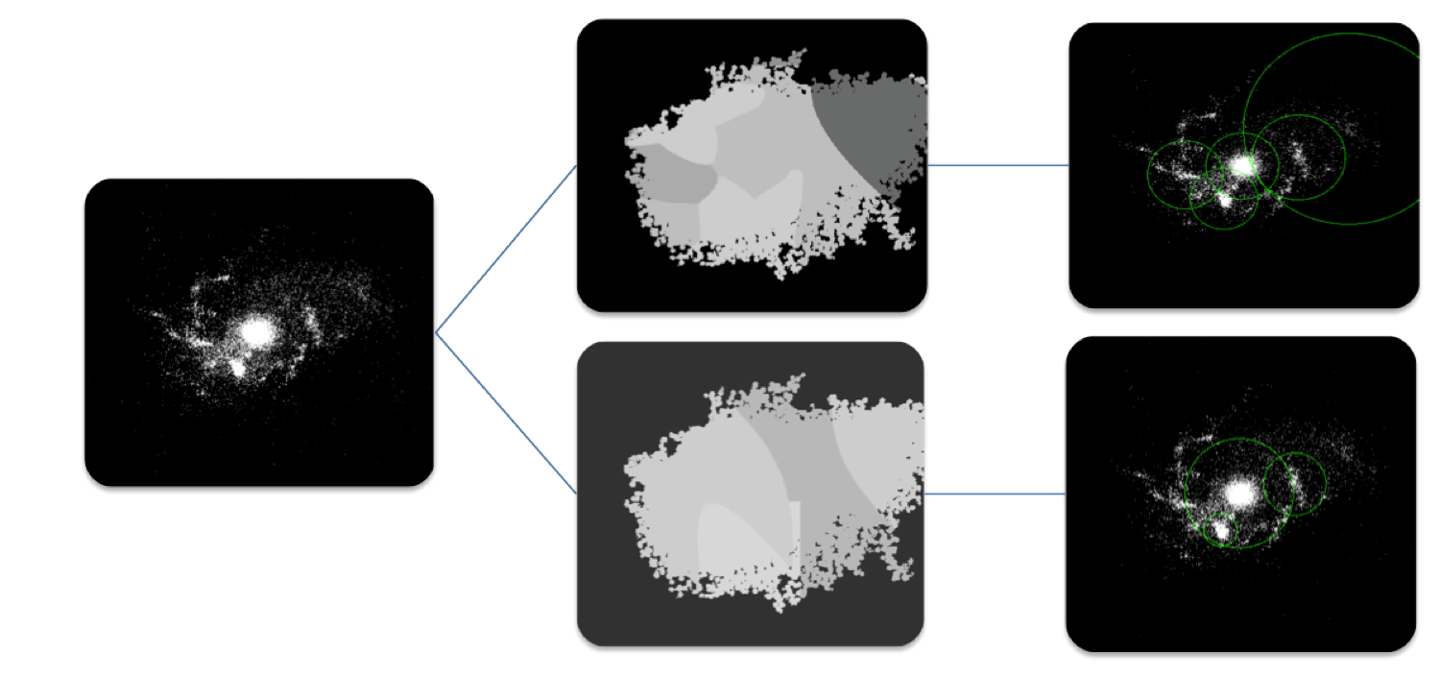
Challenges we’ve faced
Locating galaxies in the image
Coming up with a good configuration file or settings that work for all images
Evaluating the GALFIT outputs
Notes:
Locating galaxies in the image – before employing the program Source Extractor, we had a problem with locating the galaxies correctly in the images
Coming up with settings that work for all images – This work is still in the process and can be improved with a better parameter file
Evaluating the GALFIT outputs – put together images corresponding to the same galaxy from colossal number of images produced and spot the outliers

Slide 8
What we have left to do
Come up with a better Source-Extractor file such that it yields good results for a higher percentage of image
Sent the guesses from Source-Extractor through GALFIT whose aggregate data can be used to see how well the simulations agree with the actual observations

Slide 9
Acknowledgements
Thank you all for the support:
Prof.McGrath, our projects supervisor
Grant, for their sponsorship
Colby College, for issuing the necessary facilities
……, for providing the excellent simulations
Notes:
Locating galaxies in the image – before employing the program Source Extractor, we had a problem with locating the galaxies correctly in the images
Coming up with settings that work for all images – This work is still in the process and can be improved with a better parameter file
Evaluating the GALFIT outputs – put together images corresponding to the same galaxy from colossal number of images produced and spot the outliers

